Slide 1


Salutations my name is solutionator in this site you get to learn skills that are not typically taught in school
SAC
continue

Slide 2



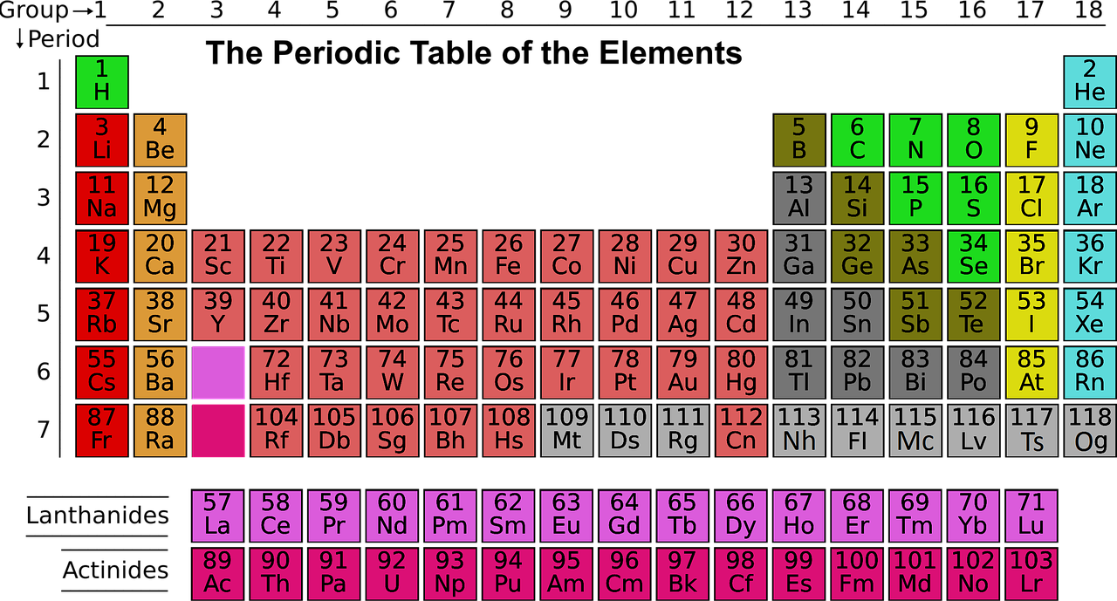


PICKING careers
THIS IS THE WORKSHOP WHERE WE CAN LEARN ALL TYPES OF THINGS JUST CLICK ON THE TOPIC YOU LIKE MOST
SAC
S
A
C
SAC
SAC

Slide 3
PICKING careers
Now click the link and give your view on our website
SAC
SA
S
A
C
SAC

